Slide 1
JavaScript is NOT A Dirty Word
James Bender
Ignite UI Product Manager, Infragistics
www.IgniteUI.com
@JamesBender
Notes:
Visual Studio Live! Las Vegas 2011MGB 2003
© 2003 Microsoft Corporation. All rights reserved.
This presentation is for informational purposes only. Microsoft makes no warranties, express or implied, in this summary.

Slide 2
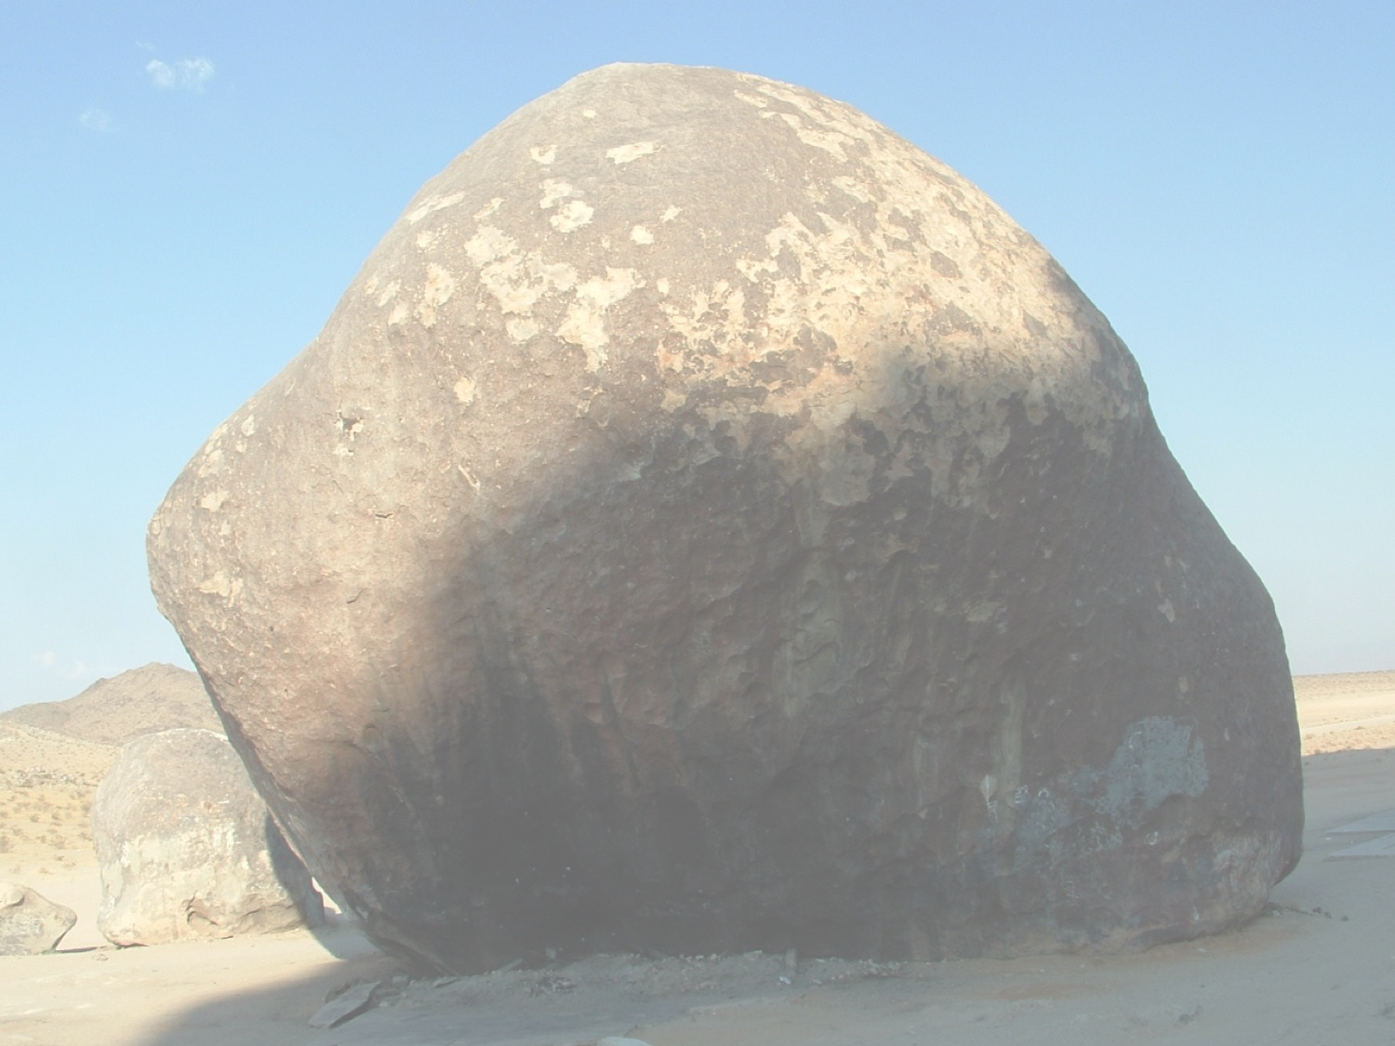
Why JavaScript?
Language of the web
Best (and worst) of both worlds
Common point of reference
The new hotness
Notes:
Photo: https://www.flickr.com/photos/66706523@N00/2865786837/in/photolist-5neUzT-5neWs4-5neXcV-8uzHjL-deHLxy-5neV5x-4ziMka-c7YCnu-2VRuP-ekkqfN-8yPsn6-fksFaF-7sZ2hv-b1Teqv-5dEfFF-aabDM8-mooW1-6V6Rv5-7dFwmL-agwu6j-nbr81-7Ntj1F-6yeCHP-8fvmAP-cqCoMJ-2hT2-agakhj-oNEtww-6TPRer-aonn51-dcDiKa-oiHz7U-c65RfS-2TtPjT-7X88Nt-dh3WrH-ayxwTh-bJrgja-cYn55m-9ZdPPd-4ys6mJ-6vqVsR-76Wt8K-8yPnfK-bBQfBe-a9jQpx-efNfH8-7g55Yj-gLmCX7-eQ2Ee/
Visual Studio Live! Las Vegas 2011MGB 2003
© 2003 Microsoft Corporation. All rights reserved.
This presentation is for informational purposes only. Microsoft makes no warranties, express or implied, in this summary.

Slide 3







Slide 4

Notes:
The DOM (api of the browser) sucks, JavaScript gets blamed
Not strongly typed, can’t rely on a compiler
having a complier doesn’t eliminate need for testing
Prototyplical inheritance as opposed to classical OOP
Photo: https://www.flickr.com/photos/bethanypetrik/8117093411/in/photolist-dnhe5p-qdJHQ-6AzGth-9LbNBa-6rXrNE-4CC1pD-fSaQpC-9Npskj-755YJD-5ttuuy-eToWqo-ePGGSb-9CNVP3-ePGKmq-6koV5R-5ttzVA-5ttyLU-5tp62v-4L3xAG-e1rSbQ-NTYA7-ctSWDu-ijoqmk-h5Tdys-bqpKyb-6Md9nt-xhYRw-nWtRp-5qKWP8-a7hhA-71jGa2-eCQz4-4Er2xe-eCQqX-33EARy-PdaAv-fMR14a-knj23x-8sEDVq-i8SrkX-4De2NM-dQL7uE-dkCmEC-knj1Zr-dD8Ucb-hLPU4t-7JbTQG-nkPxsw-e9m7WU-5HE5ct
Visual Studio Live! Las Vegas 2011MGB 2003
© 2003 Microsoft Corporation. All rights reserved.
This presentation is for informational purposes only. Microsoft makes no warranties, express or implied, in this summary.

Slide 5
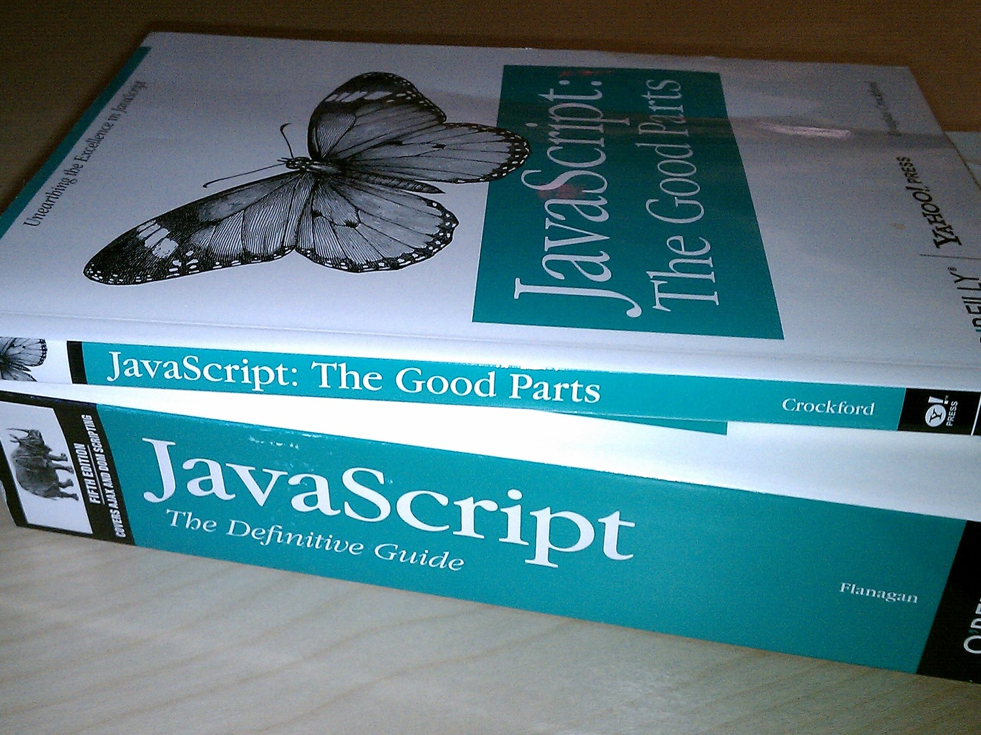
Notes:
Possible to get work done, even if you don’t know a lot of JS
JS has some VERY good idea, but is also has some VERY bad ones
Bad ideas:
global namespace
Photo: https://www.flickr.com/photos/nathansmith/4704268314/in/photolist-8aGB5o-68AyEG-dK856s-62CHS6-57J9kr-gMkaX-7hmFbw-nPGQDi-65614q-62rSav-nbs7US-7B1JCC-5w5VFy-3MsQk8-4ar6jo-9CCm2T-3dTJP6-bGNFcp-7HUAmY-5mccNp-bygGWD-7yd2fq-9aqYH-6C2SLg-62TwqQ-76cxJ9-3cpzbd-83Lrtk-m3iPg-5cooym-bnTu2P-kCq1v-4Lxrjt-pk5eQa/
Visual Studio Live! Las Vegas 2011MGB 2003
© 2003 Microsoft Corporation. All rights reserved.
This presentation is for informational purposes only. Microsoft makes no warranties, express or implied, in this summary.

Slide 6

Notes:
The DOM (api of the browser) sucks, JavaScript gets blamed
Not strongly typed, can’t rely on a compiler
having a complier doesn’t eliminate need for testing
Prototyplical inheritance as opposed to classical OOP
Photo: https://www.flickr.com/photos/bethanypetrik/8117093411/in/photolist-dnhe5p-qdJHQ-6AzGth-9LbNBa-6rXrNE-4CC1pD-fSaQpC-9Npskj-755YJD-5ttuuy-eToWqo-ePGGSb-9CNVP3-ePGKmq-6koV5R-5ttzVA-5ttyLU-5tp62v-4L3xAG-e1rSbQ-NTYA7-ctSWDu-ijoqmk-h5Tdys-bqpKyb-6Md9nt-xhYRw-nWtRp-5qKWP8-a7hhA-71jGa2-eCQz4-4Er2xe-eCQqX-33EARy-PdaAv-fMR14a-knj23x-8sEDVq-i8SrkX-4De2NM-dQL7uE-dkCmEC-knj1Zr-dD8Ucb-hLPU4t-7JbTQG-nkPxsw-e9m7WU-5HE5ct
Visual Studio Live! Las Vegas 2011MGB 2003
© 2003 Microsoft Corporation. All rights reserved.
This presentation is for informational purposes only. Microsoft makes no warranties, express or implied, in this summary.

Slide 7
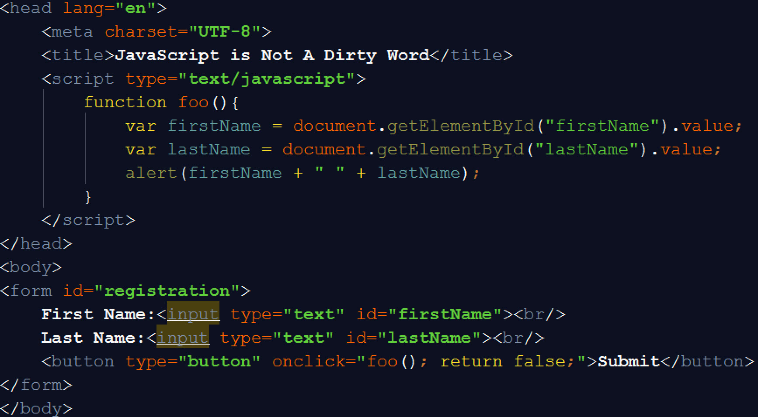

Slide 8
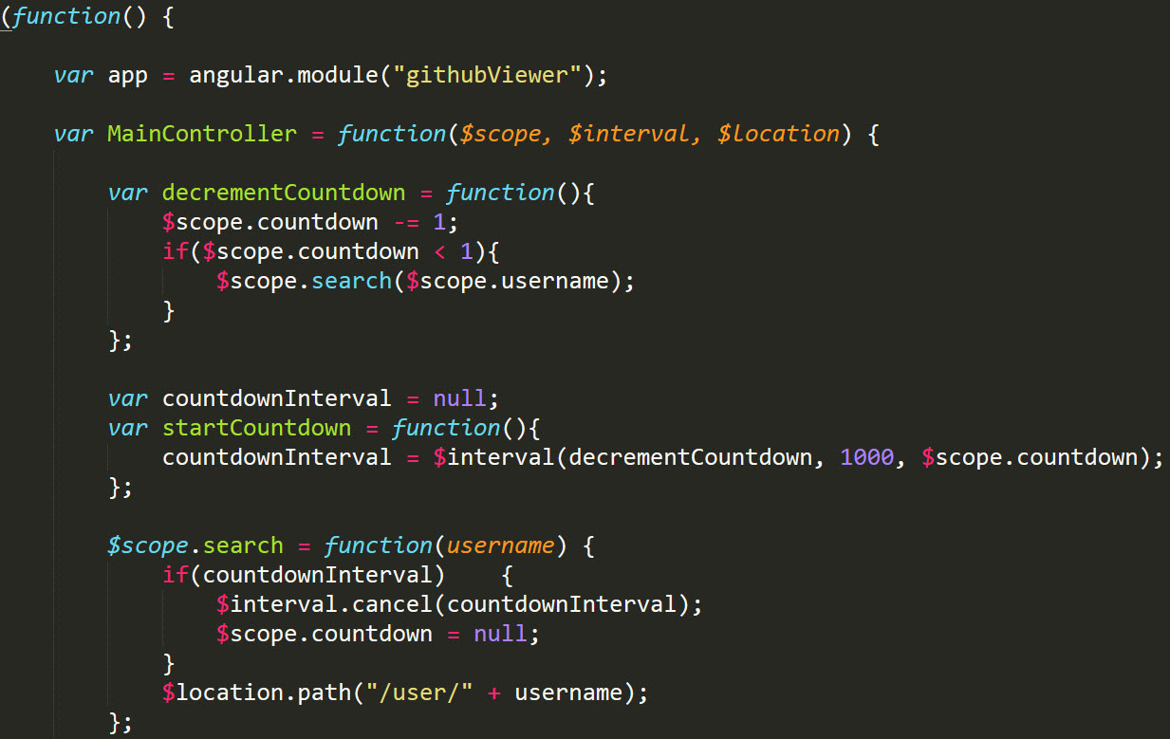

Slide 9
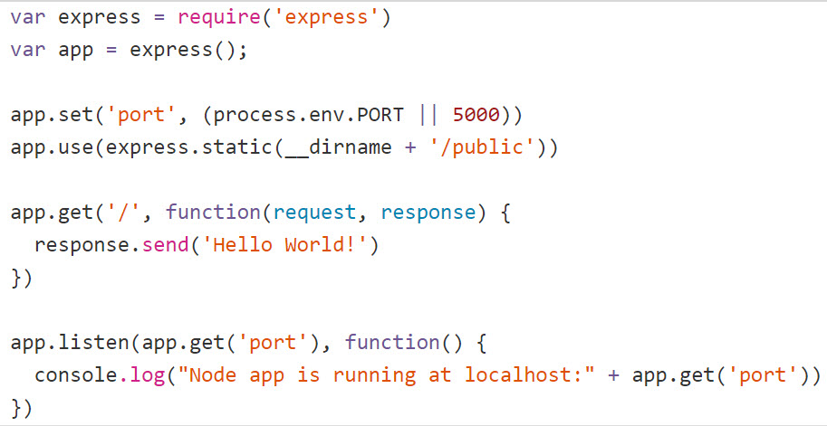

Slide 10
JavaScript only has six primitive types
Numbers
Strings
Booleans
Null
Undefined
Everything else is an Object
No, really. EVERYTHING
Notes:
Dates are an object
Objects in JS are mutable key/value pairs
Objects are class-free
Visual Studio Live! Las Vegas 2011MGB 2003
© 2003 Microsoft Corporation. All rights reserved.
This presentation is for informational purposes only. Microsoft makes no warranties, express or implied, in this summary.

Slide 11
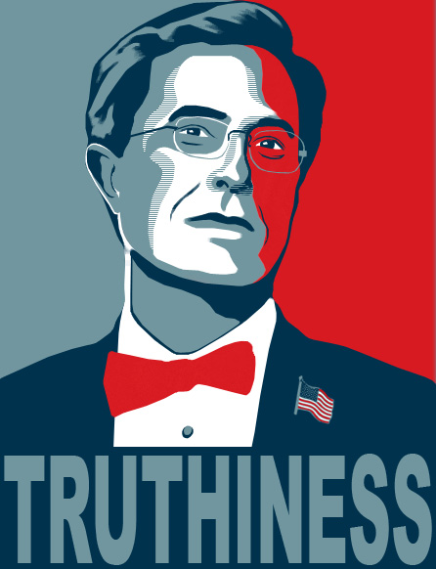
Truthy/Falsy
Values are ‘falsy’ if…
False
0 (zero)
“” (empty string)
Null
Undefined
NaN (not a number)
Notes:
All things in JavaScript evaluate to a boolean, hence truthy/falsy
“0” and ”false” are true
null and undefined false are not equal to other false
var f = (null == false); // false
var g = (null == null); // true
var h = (undefined == undefined); // true
var i = (undefined == null); // true
NaN false is not equal to anything
https://www.sitepoint.com/javascript-truthy-falsy/
Visual Studio Live! Las Vegas 2011MGB 2003
© 2003 Microsoft Corporation. All rights reserved.
This presentation is for informational purposes only. Microsoft makes no warranties, express or implied, in this summary.

Slide 12
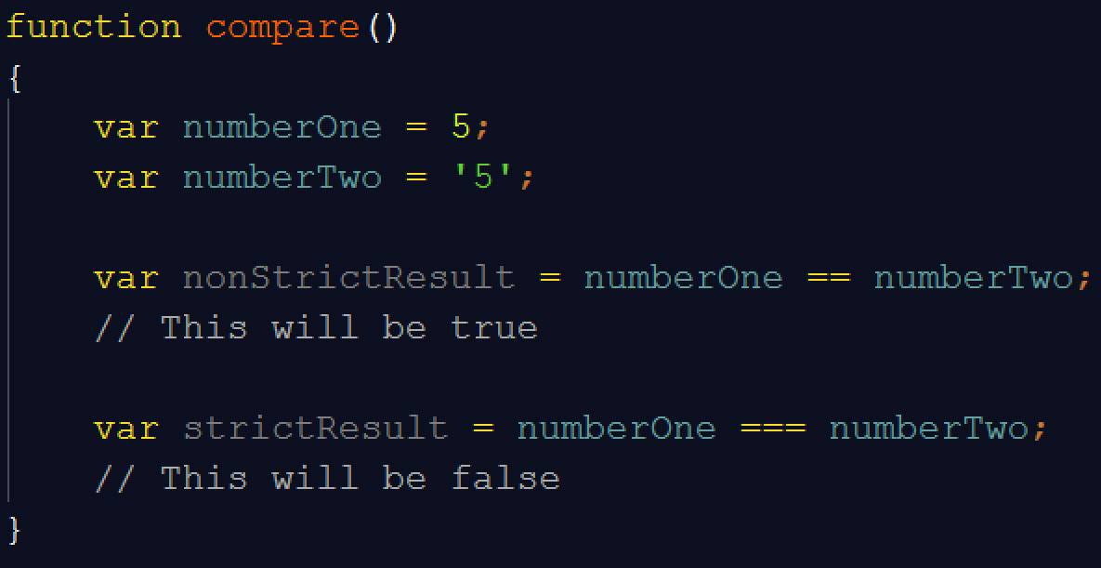
More Comparison Wackiness
Notes:
DEMO
Visual Studio Live! Las Vegas 2011MGB 2003
© 2003 Microsoft Corporation. All rights reserved.
This presentation is for informational purposes only. Microsoft makes no warranties, express or implied, in this summary.

Slide 13
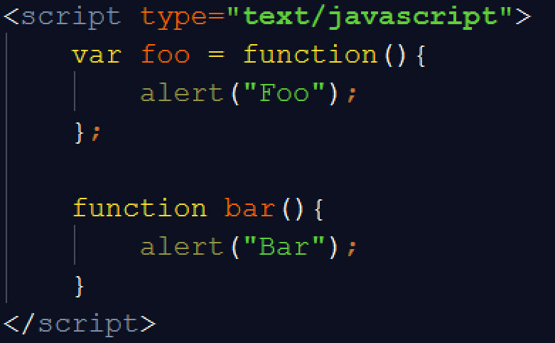
Declaring Functions
Notes:
JS is a compiled language (JIT)
Compiler -> Engine
Parsing – var foo = function → two setps
compilers asks scope if it has foo
compiler creates statement “foo = function…”
Visual Studio Live! Las Vegas 2011MGB 2003
© 2003 Microsoft Corporation. All rights reserved.
This presentation is for informational purposes only. Microsoft makes no warranties, express or implied, in this summary.

Slide 14
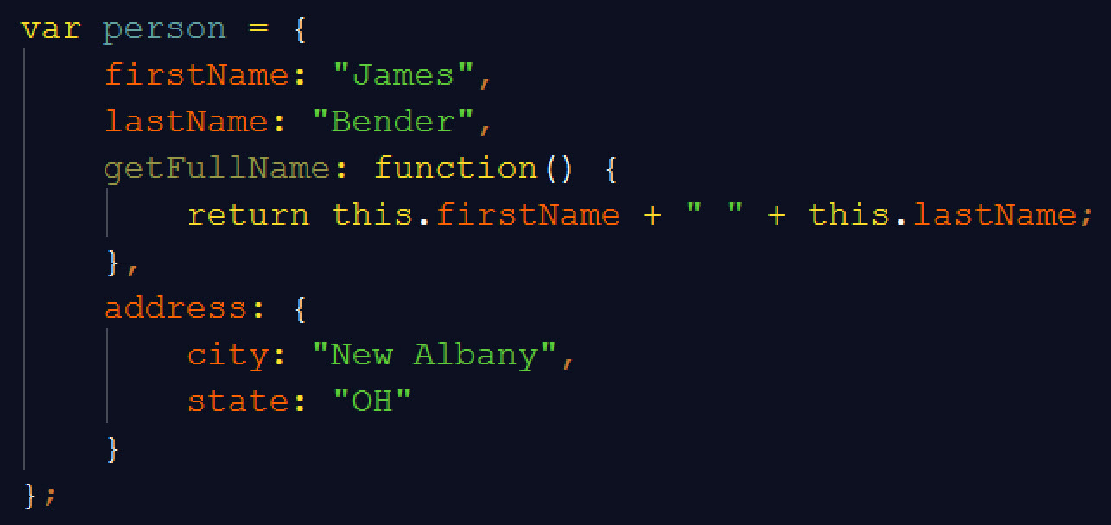
Objects
Notes:
DEMO
Visual Studio Live! Las Vegas 2011MGB 2003
© 2003 Microsoft Corporation. All rights reserved.
This presentation is for informational purposes only. Microsoft makes no warranties, express or implied, in this summary.

Slide 15
Tools and helpers
Jasmine – Unit testing framework for JavaScript
JSLint – Static analysis tool for JavaScript
Plunker – Online tool to write, test and share your JavaScript code (http://plnkr.co/)
JavaScript: The Good Parts by Douglas Crockford

Slide 16

Thank you!
Want to learn more?
www.IgniteUI.com
www.JamesCBender.com
github.com/JamesBender
james@jamescbender.com
Twitter: @JamesBender
hallwayconversations.com

